Slide 1
Implementing a DevSecOps Framework
Continuous Deployment Methods & Practices
Dr. Jeffrey S. Ray, PMP, CSEP, P.E., Esq.
© 2024 Jeffrey S. Ray
Notes:
Text
Text

Slide 2
Implementing a DSO Framework
Moving the consideration of software and cybersecurity issues to the left on their schedules is regarded as a shift-left movement in development and makes security considerations an essential part of every development phase, iteration and sprint.

Slide 3
Implementing a DSO Framework
DevSecOps Background:
DevSecOps concerns the addition of security considerations to an organization’s Continuous Integration (CI)/Continuous Deployment (CD) workflows.
The organization’s existing workflow paradigms are expanded by adding a layer of security throughout the Life Cycle Development Process (LCAP).
Projects are often guilty of pushing security analysis and checks to the right to later stages of development, on their project schedules, such as to the testing phase.
Security issues identified during testing at the end of a development phase demand more time, funding and resources to identify, duplicate and fix.
Bigelow (2022) advises that the goal of DevSecOps is to design, build, test and deploy software in which developers assign as much importance and consideration to security as any other major software feature or functionality.
Bigelow, Stephen J. (2022). How to create and manage a rock-solid DevSecOps framework. Techtarget.com, 08-10-2022.
Downloaded on 10-23-2022 at:
https://www.techtarget.com/searchitoperations/tip/How-to-create-and-manage-a-rock-solid-DevSecOps-framework.
Notes:
3

Slide 4
Implementing a DSO Framework
DevSecOps Benefits:
Reduced security risk to organizations, users and customers;
Detection of software flaws and vulnerabilities early in the product lifecycle;
Faster remediation of security issues;
Improved communication and collaboration across development, security and operations teams; and
Better overall code quality (Bigelow, 2022, pg. 1).
DevSecOps Drawbacks:
Introduction of changes, and possible bottlenecks, to existing workflows;
Additional training and expertise is necessary for both the development and security teams; and
Disrupted development workflows result due to poor communication of initiatives that aim for zero vulnerabilities (Bigelow, 2022, pg. 1).
Notes:
4

Slide 5
Implementing a DSO Framework
Steps for implementing DevSecOps:
Develop and mandate a process for consideration of security concerns during planning phases. Bring security concerns and requirements into the planning phase, as well as during sprint planning.
Create Coding Standards and establish processes for conducting peer reviews.
Security flaws enter a product when developers use different programming methodologies to write various sections of code in different ways. A team that establishes and enforces a consistent set of coding standards, and then evaluates the code base against it, can prevent mistakes that introduce vulnerabilities.
Peer code reviews help ensure that software meets coding standards and that developers catch common programming errors and vulnerabilities (Bigelow, 2022).
Identify, select, acquire, and use Security Plugins for the Integrated Development Environment (IDE).
IDEs are extensible platforms that can accept security plugins to check code for potential vulnerabilities, in the same way that the IDE would point out missing punctuation or syntax errors.
IDE-based security checks offer developers static code analysis before they make any commits to a repository.
Notes:
5

Slide 6
Implementing a DSO Framework
Steps for implementing DevSecOps:
Identify, select, and obtain Threat Modeling tools and methodologies. Common threat modeling methodologies include STRIDE, DREAD and OWASP. Multiple threat models can be combined to strengthen design security.
Develop and mandate a process for conducting Threat Modeling.
Threat modeling encourages developers to approach an application as a hacker would. They should consider potential abuses of the application, ways to prevent those abuses and how to prioritize those preventative actions in the application design goals.
Establish Secure Coding and code management techniques to ensure security in code commits. Put security at the center of codebase management and maintenance to avoid introducing vulnerabilities.
Notes:
6

Slide 7
Implementing a DSO Framework
Steps for implementing DevSecOps:
Develop and mandate a process for management of Security Dependencies.
External libraries, open-source code and reused modules are common in software development but incorporating them into your code baseline may introduce security threats and vulnerabilities.
External code will not include the same security standards and precautions as internal work.
Developers should review the security of all dependencies, verify that they are authentic and delivered securely, and ensure that the latest versions are used for each project.
Software supply chain attacks put internally developed products at risk. One way to handle this is to create a Software Bill of Materials (SBOM).
Notes:
7

Slide 8
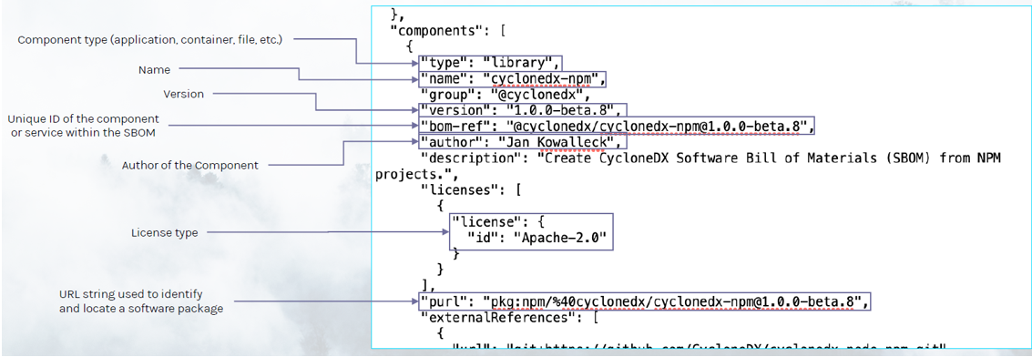
Implementing a DSO Framework
Steps for implementing DevSecOps:
Develop and mandate a process for the creation and use of an SBOM. An SBOM is a nested inventory for software, or a list of ingredients that make up software components. The figure depicts how Manifest 5 constructs an SBOM.
Figure 1. Manifest 5’s SBOM Metadata Construct . Note: The figure depicts how SBOM metadata is used to track the version, components, libraries and OS dependencies, of open source software items to ensure their stability, security, and integrity using Software Package Data Exchange (SPDX), or Common Platform Enumeration (CPE), to generate SBOMs.
Notes:
8

Slide 9
Implementing a DSO Framework
Steps for implementing DevSecOps:
Creation and management of the Manifest 5 SBOM construct (see Figure 1) is focused on complying with the EO 14028 requirement to improve the security and integrity of software supply chains.
Manifest 5 advises that SBOMs help you vet software vendors, manage cybersecurity vulnerabilities, and to harden critical systems.
Build Catalogs of Approved Open Source Components that have maintainer validated processes to ensure compliance with National Institute of Standards and Technology (NIST) security standards that need to be developed and maintained.
Notes:
9

Slide 10
Implementing a DSO Framework
Steps for implementing DevSecOps:
Develop and mandate a process for scanning code and repositories.
Repository scanning tools can perform static analysis of code committed to repositories before build execution, checking for vulnerabilities, hardcoded credentials and other common oversights.
Vulnerability testing and other static testing are vital for code security.
Repository scanning adds safety for larger teams in which many developers access the same repository. Code scans can be initiated through a command-line (CLI) option, build automation (e.g., Maven, Gradle, GitHub Action), through a simple API call, or a secure code upload.
Based on OWASP Benchmark scores, Contrast Scan has achieved an accurate static analysis solution that allows organizations to focus limited staff resources on the critical vulnerabilities that matter.
Notes:
10

Slide 11
Implementing a DSO Framework
Steps for implementing DevSecOps:
Develop and mandate a process for securing the development pipeline.
Upon detecting a security issue, a comprehensive DevSecOps framework must adjust the development workflow to prevent code commits to default or trunk branches until issues are remediated.
An attacker could also compromise the pipeline itself by introducing malicious code or stealing credentials. Consequently, organizations should implement and review security controls within their development pipelines.
Improve testing competency to Detect Application Flaws and security issues.
Testing should detect application flaws and security issues. Automation and orchestration in build, test and release pipelines should include running security tools when code is deployed for testing. For example, checking for vulnerabilities during unit testing.
Common test considerations for a DevSecOps framework include Integrating Dynamic Application Security (IDAS) testing and securing the infrastructure.
Notes:
11

Slide 12
Implementing a DSO Framework
Steps for implementing DevSecOps:
Integrate Penetration Testing and Dynamic Application Security Testing (DAST).
DAST and penetration testing have historically been the last step in the development cycle. DevSecOps adherents should add DAST, Pen Testing and other types of dynamic vulnerability testing to the build's test regiment within the pipeline.
Full DAST and other dynamic vulnerability testing, such as security acceptance testing, can be time-consuming, but lighter test regiments are an option that can yield faster results, while identifying issues missed in static testing.
Develop and mandate a process for Securing the Infrastructure.
DevSecOps security considerations should go beyond the application itself to include the deployment environment, whether local or cloud infrastructure.
Consider implementing policy-driven VMs, containers and Kubernetes clusters.
Tools such as Microsoft Azure Policy and AWS Organizations enforce security-driven policies on cloud infrastructures.
Infrastructure as Code (IaC) is one way to build standard and known-good application environments.
Notes:
12

Slide 13
Implementing a DSO Framework
Steps for implementing DevSecOps:
Develop and mandate a process for carrying DevSecOps practices forward into deployment and operational environments.
Develop and mandate a process for applying Configuration Management (CM) Controls on the infrastructure baseline.
The infrastructure environment created to host the application must be stable.
Any attempt to change an established infrastructure configuration could be malicious activity, so changes should be subject to change control procedures.
Tools that monitor and enforce an infrastructure configuration should be a central element of an organization's DevSecOps framework.
Cloud providers offer these tools as well, such as Microsoft Defender for Cloud and Microsoft Sentinel.
Notes:
13

Slide 14
Implementing a DSO Framework
Steps for implementing DevSecOps:
Develop and mandate a process for Intrusion Detection and Behavioral Analytics.
Analytics tools, including intrusion detection and prevention systems, establish baselines in traffic patterns and performance and then look for anomalies to those patterns indicative of suspicious or malicious activity in the workload or network.
Develop and mandate a process for conducting ongoing security testing.
Such tools are well established and should be embraced by organizations adopting DevSecOps.
Notes:
14

Slide 15
Implementing a DSO Framework
Steps for implementing DevSecOps:
Implement comprehensive Alerting and Reporting to align with security tools and policies.
Security tools and policies must be aligned with a comprehensive alerting and reporting approach.
Developers and project stakeholders should receive actionable intelligence from operations in a way that supports prompt issue identification and remediation.
Develop and mandate a process for conducting Post-Mortem Evaluations.
Even with the best security efforts, an organization is likely to eventually experience security issues in its application or infrastructure.
When a security incident occurs, it's important to conduct post-mortems. Teams should work to identify and remediate the issue and then use the experience to tune future development and operational efforts to prevent subsequent issues.
Notes:
15

